Slide 1
DISTRIBUTED SYSTEMS VII SEM
UNIT 1 GOALS, CHARACTERISTICS, TYPES OF DIS, ARCHITECTURAL STYLES
By
D Radhika
Asst Prof
SCETW

Slide 2
DIS UNIT 1
Syllabus Overview
Course Objectives, Outcomes
Introduction
Defining Distributed Systems
Example Distributed Systems
Reasons for Distributed Systems
Consequences of Distributed Systems
Polling Questions AND MORE

Slide 3

Introduction
Networks of computers are everywhere!
Mobile phone networks
Corporate networks
Factory networks
Campus networks
Home networks
In-car networks
On board networks in planes and trains
Notes:
Mobile - GSM/3G networks, cell towers connect to backbones
Corporate - LAN, consisting of PC’s, laptops, servers, storage, printing
Factory - Machines (drills, stamps, robots) communicate over network
Campus - Like CSSE Dept / Unimelb. Wired/wireless, clients, servers
Home - Laptops, PC’s, Xbox/Playstation, Set top boxes
In-car - Network of sensors (monitoring engine, breaks, tires etc)

Slide 4
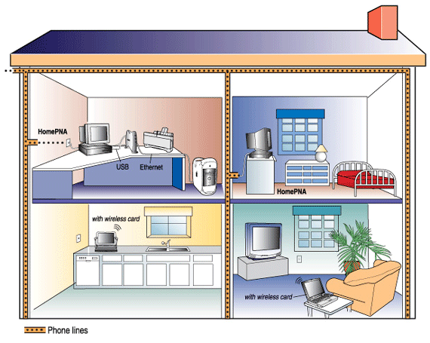

Slide 5
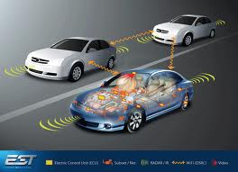

Slide 6
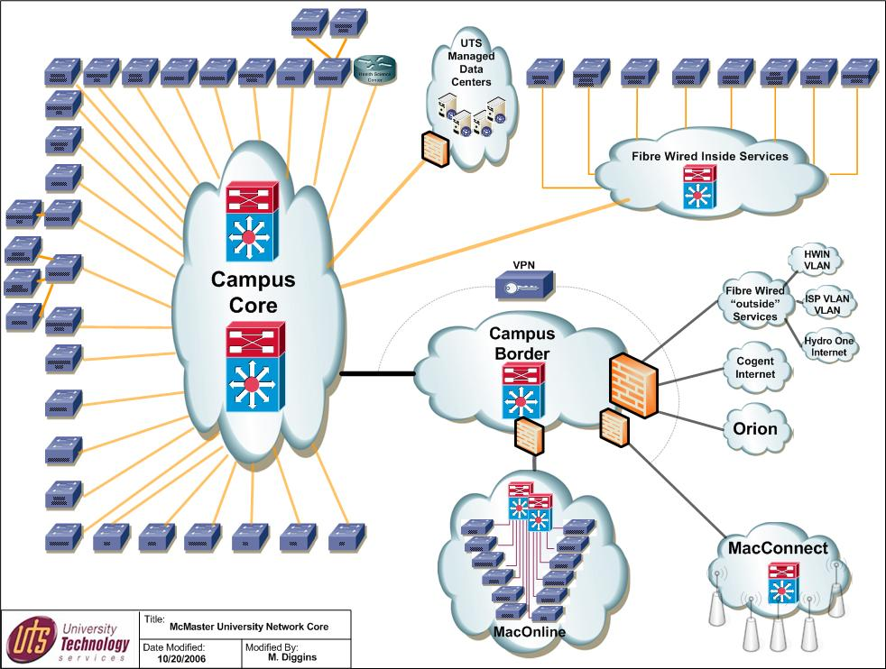

Slide 7
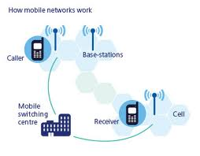

Slide 8
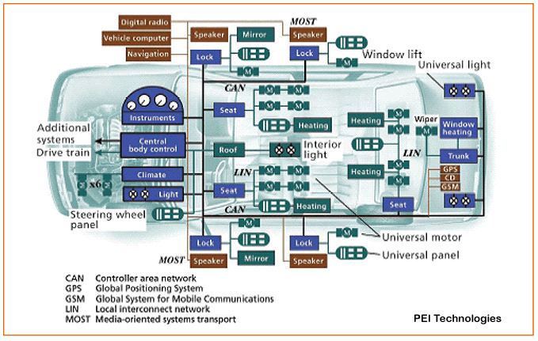

Slide 9
Defining Distributed Systems
“A system in which hardware or software components located at networked computers communicate and coordinate their actions only by message passing.” [Coulouris]
“A distributed system is a collection of independent computers that appear to the users of the system as a single computer.” [Tanenbaum]
Notes:
Top definition is from CDK book - I would expand the definition to include sensors as well, although sensors could be considered computers.
Second definition encapsulates a key aspect of DS, transparency!
Cluster is typically many machines located in the one place
Grid can consist of many clusters interconnected and shared.

Slide 10
Definition of a Distributed System
A distributed system is a collection of independent computers that appears to its users as a single coherent system.
Important aspects:
· a distributed system consists of components (i.e., computers) that are autonomous
· users (people or programs) think they are dealing with a single system
· autonomous components need to collaborate
Goal of distributed systems development: establish this collaboration.

Slide 11
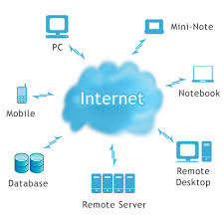
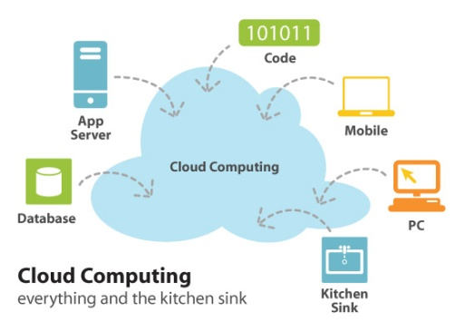

Examples of Distributed Systems
They (DS) are based on familiar and widely used computer networks:
Internet
Intranets, and
Wireless networks
Example DS:
Web (and many of its applications like Facebook)
Data Centers and Clouds
Wide area storage systems
Banking Systems
Notes:
Most of you should have used all of these DS.

Slide 12
A typical portion of the Internet and its services: Multimedia services providing access to music, radio, TV channels, and video conferencing supporting several users.
Intranet
%
ISP
%
%
%
backbone
satellite link
desktop computer:
server:
network link:
The Internet is a vast collection of computer networks of many different types and hosts various types of services.
Notes:
Programs run on computers, and they interact via message passing
The internet is a very large DS, consisting of many participants.
Governments, and large telcos operate the backbones that carry the bulk of the traffic
ISP’s provide connectivity between the backbones and smaller networks
Many services run, email, www, ftp, video/audio streaming etc.

Slide 13







A typical Intranet: A portion of Internet that is separately administered & supports internal sharing of resources (file/storage systems and printers)
Desktop computers
Print and other servers
email server
Local area
Web server
network
email server
print
File server
other servers
the rest of
the Internet
router/firewall
Notes:
Intranet is a seperately administered DS, that has a boundary between intra and internet.
Intranet can be one small LAN or many interconnected private sites.
Firewall can be used to allow authorised users in & out but keep unwanted / malicious users from causing harm.
Some intranets (e.g. Defence, Hospitals) may choose to keep them entirely separate from the internet to ensure security.

Slide 14


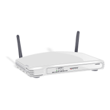





Mobile and ubiquitous computing: portable and handheld devices in a distributed system
Internet
WAP
Home Intranet
Host Intranet
Wireless LAN
gateway
Printer
Mobile
phone
Camera
Laptop
Host site
Supports continued access to Home intranet resources via wireless and provision to utilise resources (e.g., printers) that are conveniently located (location-aware computing).
Notes:
We are at a point where many of our devices have short (BT) and medium range (WiFi) wireless - camera, PDA, mobile, laptop, etc
They are creating ad-hoc DS in our homes!
Bonjour / Zeroconf enable location aware, ad-hoc distributed computing - find local file servers, printers, other users via advertising messages

Slide 15
Resource sharing and the Web: open protocols, scalable servers, and pluggable browsers
http://www.google.com/search?q=Buyya
www.google.com
Web servers
Browsers
www.cdk5.net
Internet
Internet
http://www.cdk5.net/
www.w3c.org
File system of
http://www.w3c.org/Protocols/Activity.html
www.w3c.org
Protocols
Activity.html
Notes:
User types in a URL into a web browser, and many things happen:
The server that hosts the page is located
The protocol is identified (in this case, HTTP)
The relevant service is called upon (e.g. the webserver) to satsify request
The particular page that is requested is located and returned to user

Slide 16
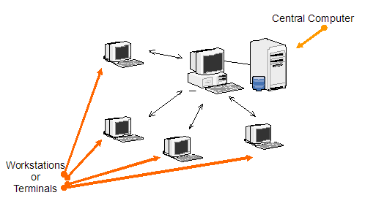
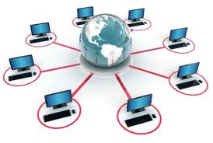
Reasons for Distributed Systems (WHY)
Functional Separation:
Existence of computers with different capabilities and purposes:
Clients and Servers
Data collection and data processing
Inherent distribution:
Information:
Different information is created and maintained by different people (e.g., Web pages)
People
Computer supported collaborative work (virtual teams, engineering, virtual surgery)
Retail store and inventory systems for supermarket chains (e.g., Coles, Woolworths)
Power imbalance and load variation:
Distribute computational load among different computers.
Reliability:
Long term preservation and data backup (replication) at different locations.
Economies:
Sharing a printer by many users and reduce the cost of ownership.
Building a supercomputer out of a network of computers.
Notes:
There are many practical reasons to utilise DS:
Functional Separation: Beneficial to separate collection from processing
Inherent dist: The process/activity is naturally distributed
Power/ load: We are forced to use DS as one system cannot handle!
Reliability: Government reg. may force us to retain data for 10 years
Economies: Share resources, statistical multiplexing

Slide 17
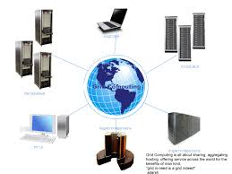
Consequences of Distributed Systems
Computers in distributed systems may be on separate continents, in the same building, or the same room. DSs have the following consequences:
Concurrency – each system is autonomous.
Carry out tasks independently
Tasks coordinate their actions by exchanging messages.
Heterogeneity
No global clock
Independent Failures
Notes:
Consequencies are problems that need solving when we choose DS:
Concurrency: Tasks happen independently, but periodically convenve to exchange status update or other information. We need to deal with it.
Heterogeneity: Different hardware, different software, different protocols
No global clock: We cannot assume correctness of timing given.
Ind. Failures: Many components working together (ie goog), any can fail

Slide 18
*****Polling Questions
Q) In Distributed Systems the differences between various computers and the ways in which they communicate are mostly hidden from users
True or False
Q) Identify one correct reason for choosing Distributed Systems
A) Functional Separation
B) Not Reliable
C) Does not Distribute computational load among different computers.
D) cannot share resources

Slide 19
Characteristics of Distributed Systems
Goals of Distributed Systems

Slide 20
Characteristics of Distributed Systems
Parallel activities
Autonomous components executing concurrent tasks
Communication via message passing
No shared memory
Resource sharing
Printer, database, other services
No global state
No single process can have knowledge of the current global state of the system
No global clock
Only limited precision for processes to synchronize their clocks
Notes:
Parallel: Participants can execute their own tasks in parallel, with little or no synchronisation
Comms: With wide scale DS, there is no shared memory space to use as a ‘blackboard’. Instead, messages must be passed .
Resource sharing: We need to give ‘fair’ access to many users
No global state: See message passing, can’t know all like on single PC
No global clock: Can assume millesecond accuracy at best

Slide 21
Characteristics of distributed systems:
· differences between various computers and the ways in which they communicate are mostly hidden from users
· users and applications can interact with a distributed system in a consistent and uniform way, regardless of where and when interaction takes place.
· distributed systems should also be relatively easy to expand or scale.
· a distributed system will normally be continuously available
. Layers of software support heterogeneous computers and networks while offering a single-system view - sometimes called middleware.

Slide 22
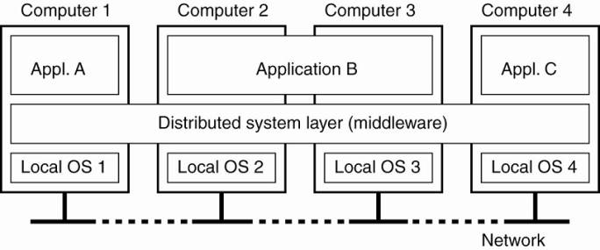
A distributed system organized as middleware.
Four networked computers and three applications:
1. Application B is distributed across computers 2 and 3.
2. Each application is offered the same interface
3. Distributed system provides the means for components of a single distributed application to communicate with each other, but also to let different applications communicate.
4. It also hides the differences in hardware and operating systems from each application.

Slide 23
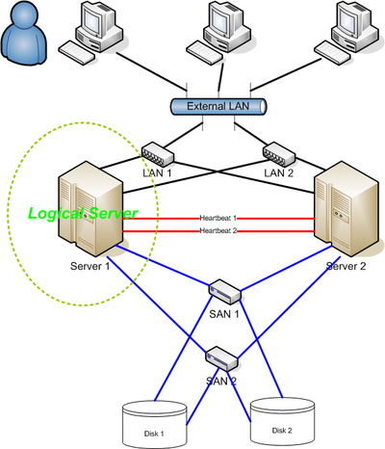
Goals of Distributed Systems
Connecting Users and Resources
Transparency
Openness
Scalability
Enhanced Availability
Notes:
Connecting users: Ultimately we want out system made widely avail.
Transperency: User should be unaware of complexity behind system, access it almost like local system.
Openness: Use standards (like http/ftp, w3 standards) so anyone can interface with, understand and extend your system
Scalability: Having near linear scaling is the ultimate goal, add capacity to deal with growth

Slide 24
1. Making Resources Accessible
Main goal of a distributed system –
· make it easy for the users (and applications) to access remote resources
· to share them in a controlled and efficient way.
Resources - anything: printers, computers, storage facilities, data, files, Web pages, and networks, etc.
Accessibility Issues
· security
· unwanted communication

Slide 25
2. Distribution Transparency
Goal - hide the fact that its processes and resources are physically distributed across multiple computers – systems should be transparent
Different forms of transparency in a distributed system (ISO, 1995).
Degree of Transparency
Issues:
· Timing:
e.g. requesting an electronic newspaper to appear in your mailbox before 7 A.M. local time, as usual, while you are currently at the other end of the world living in a different time zone.
· Synchronization:
e.g. a wide-area distributed system that connects a process in San Francisco to a process in Amsterdam limited by laws of physics - a message sent from one process to the other takes about 35 milliseconds.
· it takes several hundreds of milliseconds using a computer network.
· signal transmission is not only limited by the speed of light, but also by limited processing capacities of the intermediate switches.

Slide 26
Transparency | Description
Access | Hide differences in data representation and how a resource is accessed
Location | Hide where a resource is located
Migration | Hide that a resource may move to another location
Relocation | Hide that a resource may be moved to another location while in use
Replication | Hide that a resource is replicated
Concurrency | Hide that a resource may be shared by several competitive users
Failure | Hide the failure and recovery of a resource

Slide 27
Degree of Transparency
Issues:
· Timing:
e.g. requesting an electronic newspaper to appear in your mailbox before 7 A.M. local time, as usual, while you are currently at the other end of the world living in a different time zone.
· Synchronization:
e.g. a wide-area distributed system that connects a process in San Francisco to a process in Amsterdam limited by laws of physics - a message sent from one process to the other takes about 35 milliseconds.
· it takes several hundreds of milliseconds using a computer network.
· signal transmission is not only limited by the speed of light, but also by limited processing capacities of the intermediate switches.
. Performance:
e.g. many Internet applications repeatedly try to contact a server before finally giving up. Consequently, attempting to mask a transient server failure before trying another one may slow down the system as a whole.

Slide 28
· Consistency:
e.g. need to guarantee that several replicas, located on different continents, need to be consistent all the time - a single update operation may now even take seconds to complete, something that cannot be hidden from users.
· Context Awareness:
e.g. notion of location and context awareness is becoming increasingly important, it may be best to actually expose distribution rather than trying to hide it. - consider an office worker who wants to print a file from her notebook computer. It is better to send the print job to a busy nearby printer, rather than to an idle one at corporate headquarters in a different country.
· Limits of Possibility:
Recognizing that full distribution transparency is simply impossible, we should ask ourselves whether it is even wise to pretend that we can achieve it.

Slide 29
3. Openness
Goal: offer services according to standard rules that describe the syntax and semantics of those services.
e.g.
. computer networks - standard rules govern the format, contents, and meaning of messages sent and received.
· distributed systems - services are specified through interfaces, which are often described in an Interface Definition Language (IDL).
Interface definitions written in an IDL nearly always capture only the syntax of services
§ specify names of the available functions with types of parameters, return values, possible exceptions that can be raised, etc.
§ allows an arbitrary process that needs a certain interface to talk to another process that provides that interface
§ allows two independent parties to build completely different implementations of those interfaces, leading to two separate distributed systems that operate in exactly the same way.

Slide 30
Properties of specifications:
· Complete - everything that is necessary to make an implementation has been specified.
· Neutral - specifications do not prescribe what an implementation should look like
Lead to:
· Interoperability - characterizes the extent by which two implementations of systems or components from different manufacturers can co-exist and work together by merely relying on each other's services as specified by a common standard.
· Portability - characterizes to what extent an application developed for a distributed system A can be executed, without modification, on a different distributed system B that implements the same interfaces as A.
Goals: an open distributed system should also be extensible. i.e.
· be easy to configure the system out of different components (possibly from different developers).
· be easy to add new components or replace existing ones without affecting those components that stay in place.

Slide 31
4. Scalability
Scalability of a system is measured with respect to:
1. Size - can easily add more users and resources to the system.
2. Geographic extent - a geographically scalable system is one in which the users and resources may lie far apart.
3. Administrative scalability - can be easy to manage even if it spans many independent administrative organizations.
Note Scalability will be dealt in detail in future sessions

Slide 32
Polling Questions
Q) Openness is a Goal of Distributed System
Yes or No
Q) Hide where a resource is located
A)Location
B) Migration
C) Relocation
D) Replication

Slide 33
Types of Distributed Systems

Slide 34
Types of Distributed Systems
Distributed Computing Systems (focus on computation)
Cluster 2. Grid 3. cloud
Distributive Information Systems ( focus on interoperability)
1. Transaction Processing Systems (ACID properties)
2. Enterprise Application Integration
* Exchange of info thru RPC,RMI
Distributive Pervasive Systems (focus on mobile, embedded computing)
1. Home Systems( smart phones,PDA)
2. E-Health Care Systems (heart monitors,body area networks)
3. Sensor Networks (distributed databases connected wirelessly

Slide 35
Cluster computing
Homogeneous
Management is centralized
Used for high performance ,minimum downtime

Slide 36
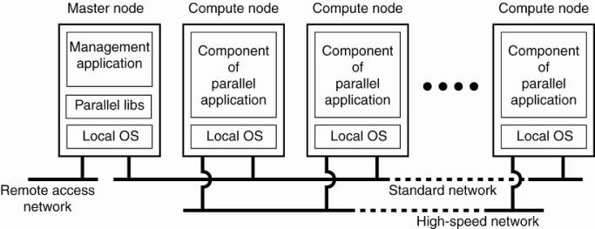
example of a cluster computing system
Hooking up a collection of simple computers via high speed networks to build a supercomputer environment
Mostly homogeneous
Ex: server clusters at banks

Slide 37
GRID COMPUTING SYSTEMS
Heterogeneous and geographically dispersed
Management is decentralized
Usage : large data repositories and high computing power requirements
Users and resources from different organization are virtually bought together to allow collaboration (virtual organization)
Ex: police, FBI,local agencies may form a computing grid

Slide 38
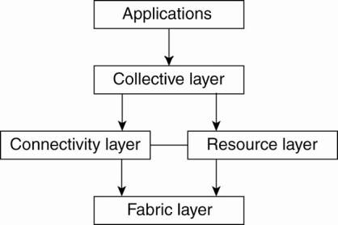
Layered architecture for grid computing systems
Fabric Layer : allows sharing ,management of resources for the members of virtual organization.
Connectivity layer -contains security protocols to authenticate users and resources.
Resource layer - responsible for managing a single resource (Access Control)
Collective layer - handles access to multiple resources, consists of services for resource discovery, allocation and scheduling of tasks onto multiple resources, data replication, etc. may consist of many different protocols for many different purposes, reflecting the broad spectrum of services it may offer to a virtual organization.
Application layer - consists of the applications that operate within a virtual organization and which make use of the grid computing environment.

Slide 39
Members of the same virtual organization have access rights to the resources that are provided to that organization.
Resources consist of compute servers (including supercomputers, possibly implemented as cluster computers), storage facilities, and databases. In addition, special networked devices such as telescopes, sensors, etc., can be provided as well.
Software required for grid computing evolves around providing access to resources from different administrative domains, and to only those users and applications that belong to a specific virtual organization.

Slide 40
Polling questions
1 Q) Grid Computing systems are Heterogeneous and geographically dispersed,Management is decentralized
Ans Yes / No
2 Q) Identify the layer that contains security protocols to authenticate users and resources.
A) Fabric B) Connectivity C) Collective D) Resoruce

Slide 41
Distributed pervasive system - is part of the surroundings
Features: general lack of human administrative control, devices can be configured by their owners, they need to automatically discover their environment and fit in as best as possible. This nestling in has been made more precise by Grimm et al. (2004) by formulating the following
Three requirements for pervasive applications (Grimm et al. 2004) :
Embrace contextual changes.: a device must be continuously be aware of the fact that its environment may change all the time
Encourage ad hoc composition. : many devices in pervasive systems will be used in very different ways by different users – make it easy to configure the suite of applications running on a device
Recognize sharing as the default. devices generally join the system in order to access (and possibly provide) information

Slide 42
Electronic Health Care Systems
· New devices are being developed to monitor the well-being of individuals and to automatically contact physicians when needed.
· Major goal is to prevent people from being hospitalized.
· Personal health care systems rea equipped with various sensors organized in a (preferably wireless) body-area network (BAN).
· Such a network should at worst only minimally hinder a person.
Organization:
1. A central hub is part of the BAN and collects data as needed. Data is then offloaded to a larger storage device.
· Advantage: the hub can also manage the BAN.
2. The BAN is continuously hooked up to an external network through a wireless connection, to which it sends monitored data.
· Separate techniques will need to be deployed for managing the BAN.
· Further connections to a physician or other people may exist as well.
Monitoring a person in a pervasive electronic health care system, using
(a) a local hub o
(b) a continuous wireless connection.

Slide 43
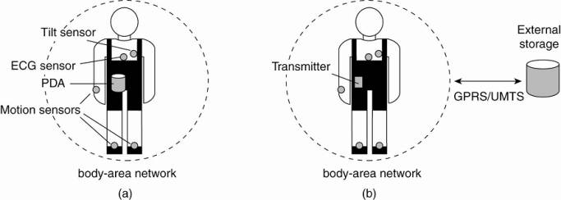
Questions:
1. Where and how should monitored data be stored?
2. How can we prevent loss of crucial data?
3. What infrastructure is needed to generate and propagate alerts?
4. How can physicians provide online feedback?
5. How can extreme robustness of the monitoring system be realized?
6. What are the security issues and how can the proper policies be enforced?
For reasons of efficiency: 1. devices and body-area networks will be required to support in-network data processing 2. monitoring data will have to be aggregated before permanently storing it or sending it to a physician.

Slide 44
Architectural Styles

Slide 45
Architectural Styles
There are four different architectural styles, plus the hybrid architecture, when it comes to distributed systems. The basic idea is to organize logically different components, and distribute those computers over the various machines.
Layered Architecture
Object Based Architecture
Data-centered Architecture
Event Based Architecture
Hybrid Architecture

Slide 46
Layered Architecture
The layered architecture separates layers of components from each other, giving it a much more modular approach. A well known example for this is the OSI model that incorporates a layered architecture whting with each of the components. Each interaction is sequential where a layer will contact the adjacent layer and this process continues, until the request is been catered to. But in certain cases, the implementation can be made so that some layers will be skipped, which is called cross-layer coordination. Through cross-layer coordination, one can obtain better results due to performance increase.
The layers on the bottom provide a service to the layers on the top. The request flows from top to bottom, whereas the response is sent from bottom to top. The advantage of using this approach is that, the calls always follow a predefined path, and that each layer can be easily replaced or modified without affecting the entire architecture.

Slide 47
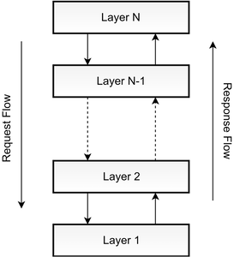

Slide 48
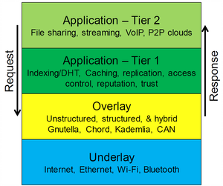
The image given below, represents the basic architecture style of a distributed system.

Slide 49
Object Based Architecture
This architecture style is based on loosely coupled arrangement of objects. This has no specific architecture like layers. Like in layers, this does not have a sequential set of steps that needs to be carried out for a given call. Each of the components are referred to as objects, where each object can interact with other objects through a given connector or interface. These are much more direct where all the different components can interact directly with other components through a direct method call.

Slide 50
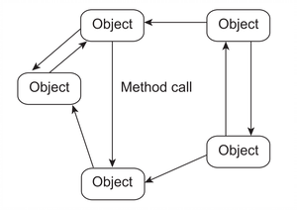
As shown in the above image, communication between object happen as method invocations. These are generally called Remote Procedure Calls (RPC). Some popular examples are Java RMI, Web Services and REST API Calls. This has the following properties.
This architecture style is less structured.
component = object
connector = RPC or RMI
When decoupling these processes in space, people wanted the components to be anonymous and replaceable. And the synchronization process needed to be asynchronous, which has led to Data Centered Architectures and Event Based Architectures.

Slide 51
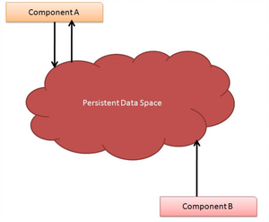
Data Centered Architecture
As the title suggests, this architecture is based on a data center, where the primary communication happens via a central data repository. This common repository can be either active or passive. This is more like a producer consumer problem. The producers produce items to a common data store, and the consumers can request data from it. This common repository, could even be a simple database. But the idea is that, the communication between objects happening through this shared common storage. This supports different components (or objects) by providing a persistent storage space for those components (such as a MySQL database). All the information related to the nodes in the system are stored in this persistent storage. In event-based architectures, data is only sent and received by those components who have already subscribed.
Some popular examples are distributed file systems, producer consumer, and web based data services.

Slide 52
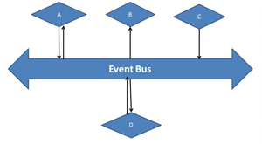
Event Based Architecture
The entire communication in this kind of a system happens through events. When an event is generated, it will be sent to the bus system. With this, everyone else will be notified telling that such an event has occurred. So, if anyone is interested, that node can pull the event from the bus and use it. Sometimes these events could be data, or even URLs to resources. So the receiver can access whatever the information is given in the event and process accordingly. processes communicate through the propagation of events.
These events occasionally carry data. An advantage in this architectural style is that, components are loosely coupled. So it is easy to add, remove and modify components in the system. Some examples are, publisher - subscriber system, Enterprise Services Bus (ESB) and akka.io.
One major advantage is that, these heterogeneous components can contact the bus, through any communication protocol. But an ESB or a specific bus, has the capability to handle any type of incoming request and process accordingly.

Slide 53
This architectural style is based on the publisher-subscriber architecture. Between each node there is no direct communication or coordination. Instead, objects which are subscribed to the service communicate through the event bus.
The event based architecture supports, several communication styles.
Publisher-subscriber
Broadcast
Point-to-Point
The major advantages of this architecture is that the Components are decoupled in space - loosely coupled.

Slide 54
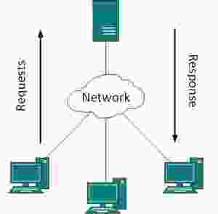
4) System Level Architecture
The two major system level architectures that we use today are Client-server and Peer-to-peer (P2P). We use these two kinds of services in our day to day lives, but the difference between these two are often misinterpreted.
Client Server Architecture
The client server architecture has two major components. The client and the server. The Server is where all the processing, computing and data handling is happening, whereas the Client is where the user can access the services and resources given by the Server (Remote Server). The clients can make requests from the Server, and the Server will respond accordingly. Generally, there is only one server that handles the remote side. But to be on the safe side, we do use multiple servers will load balancing techniques.

Slide 55
As one common design feature, the Client Server architecture has a centralized security database. This database contains security details like credentials and access details. Users can't log in to a server, without the security credentials. So, it makes this architecture a bit more stable and secure than Peer to Peer. The stability comes where the security database can allow resource usage in a much more meaningful way. But on the other hand, the system might get low, as the server only can handle a limited amount of workload at a given time.
Advantages:
Easier to Build and Maintain
Better Security and Stable
Disadvantages:
Single point of failure
Less scalable

Slide 56
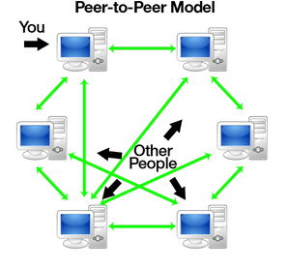
Peer to Peer (P2P)
The general idea behind peer to peer is where there is no central control in a distributed system. The basic idea is that, each node can either be a client or a server at a given time. If the node is requesting something, it can be known as a client, and if some node is providing something, it can be known as a server. In general, each node is referred to as a Peer.

Slide 57
In this network, any new node has to first join the network. After joining in, they can either request a service or provide a service. The initiation phase of a node (Joining of a node), can vary according to implementation of a network. There are two ways in how a new node can get to know, what other nodes are providing.
Centralized Lookup Server - The new node has to register with the centralized look up server an mention the services it will be providing, on the network. So, whenever you want to have a service, you simply have to contact the centralized look up server and it will direct you to the relevant service provider.
Decentralized System - A node desiring for specific services must, broadcast and ask every other node in the network, so that whoever is providing the service will respond.

Slide 58
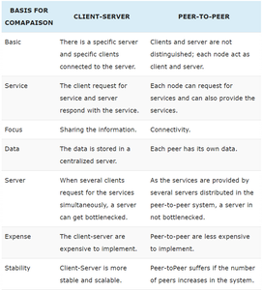
A Comparison Between Client Server and Peer to Peer Architectures

Slide 59
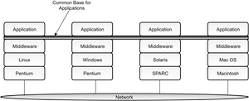
Middleware in Distributed Applications
If we look at Distributed systems today, they lack the uniformity and consistency. Various heterogeneous devices have taken over the world where distributed system cater to all these devices in a common way. One way distributed systems can achieve uniformity is through a common layer to support the underlying hardware and operating systems. This common layer is known as a middleware, where it provides services beyond what is already provided by Operating systems, to enable various features and components of a distributed system to enhance its functionality better. This layer provides a certain data structures and operations that allow processes and users on far-flung machines to inter-operate and work together in a consistent way. The image given below, depicts the usage of a middleware to inter-connect various kinds of nodes together. According to Andrew Tannenbaum, middleware is like the operating system of distributed systems.

Slide 60
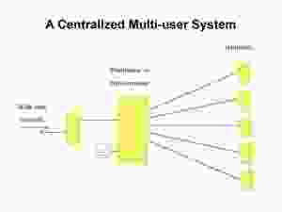
Centralized vs Decentralized Architectures
The two main structures that we see within distributed system overlays are Centralized and Decentralized architectures. The centralized architecture can be explained by a simple client-server architecture where the server acts as a central unit. This can also be considered as centralized look up table with the following characteristics.
Low overhead
Single point of failure
Easy to Track
AdditionalOverhead.

Slide 61
When it comes to distributed systems, we are more interested in studying more on the overlay and unstructured network topologies that we can see today. In general, the peer to peer systems that we see today can be separated into three unique sections.
Structured P2P: nodes are organized following a specific distributed data structure
Unstructured P2P: nodes have randomly selected neighbors
Hybrid P2P: some nodes are appointed special functions in a well-organized fashion

Slide 62
Structured P2P Architecture
The meaning of the word structured is that the system already has a predefined structure that other nodes will follow. Every structured network inherently suffers from poor scalability, due to the need for structure maintenance. In general, the nodes in a structured overlay network are formed in a logical ring, with nodes being connected to the this ring. In this ring, certain nodes are responsible for certain services.
A common approach that can be used to tackle the coordination between nodes, is to use distributed hash tables (DHTs). A traditional hash function converts a unique key into a hash value, that will represent an object in the network. The hash function value is used to insert an object in the hash table and to retrieve it.

Slide 63
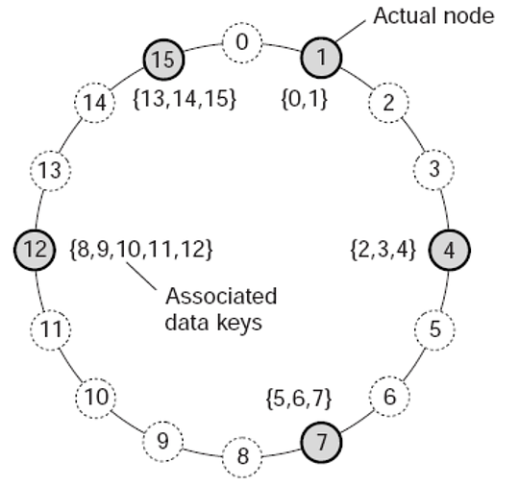

Slide 64
In a DHT, each key is assigned to a unique hash, where the random hash value needs to be of a very large address space, in order to ensure uniqueness. A mapping function is being used to assign objects to nodes based on the hash function value. A look up based on the hash function value, returns the network address of the node that stores the requested object.
Hash Function: Takes a key and produces a unique hash value
Mapping Function: Map the hash value to a specific node in the system
Lookup table: Return the network address of the node represented by the unique hash value.

Slide 65
Unstructured P2P Systems
There is no specific structure in these systems, hence the name "unstructured networks". Due to this reason, the scalability of the unstructured p2p systems is very high. These systems rely on randomized algorithms for constructing an overlay network. As in structured p2p systems, there is no specific path for a certain node. It's generally random, where every unstructured system tried to maintain a random path. Due to this reason, the search of a certain file or node is never guaranteed in unstructured systems.
The basic principle is that each node is required to randomly select another node, and contact it.
Let each peer maintain a partial view of the network, consisting of n other nodes
Each node P periodically selects a node Q from its partial view
P and Q exchange information and exchange members from their respective partial views

Slide 66
Hybrid P2P Systems:
Hybrid systems are often based on both client server architectures and p2p networks. A famous example is Bittorrent, which we use everyday. The torrent search engines provide a client server architecture, where the trackers provide a structured p2p overlay. The rest of nodes, which are also known as leechers and seeders, become the unstructured overlay of the network, allowing it to scale itself as needed and further..

Slide 67
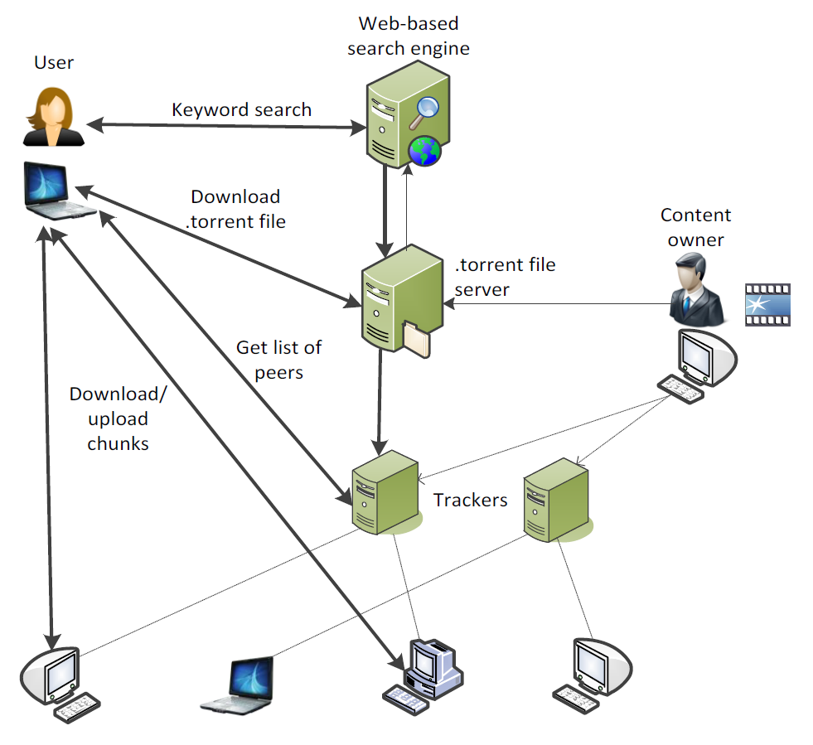

Slide 68
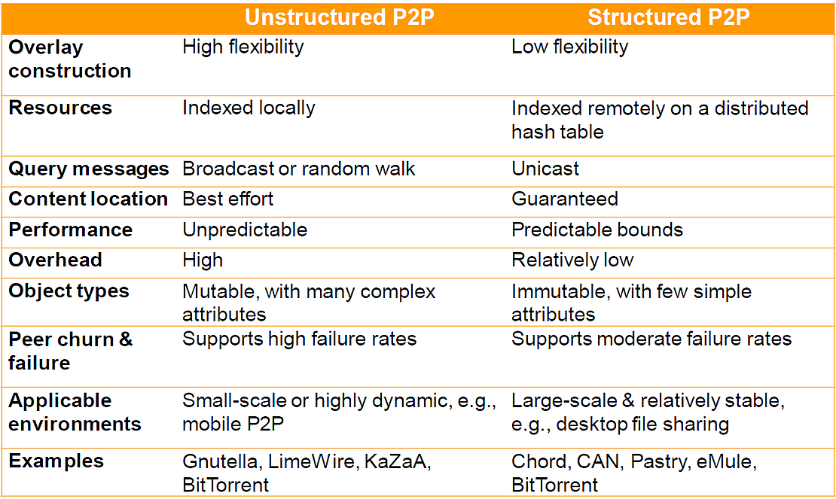
Summary on Structured and Unstructured P2P Systems

